Slide 1
Project Title - ProCoordinator
Software Project Lab - 1
Presented By-
Md. Salman Khan
ID - MUH2225027M
Email- salman2517@student.nstu.edu.bd
Supervised By-
Md. Eusha Kadir
Lecturer, Institute of Information Technology,
Noakhali Science and Technology University.
Email- eusha@nstu.edu.bd

Slide 2
Introduction
ProCoordinator is a solution to project challenges, offering easy-to-use software designs. We created it to make project workflows smoother, boost teamwork, and help users to manage their project more efficiently and timely.
It helps users to find out the best estimated timeline for a project, how to distribute resources among different parts of the project and more.

Slide 3
What does it actually means?
This project is actually a way to estimate the total duration of a project … especially effective for projects with many moving parts and dependencies.
It helps visualize a project schedule or timeline as a flowchart. It’s useful during the early stages of planning when sorting through how all the pieces go together.
For example, a project with 7 key activities and a total project duration of 14 days, could have a chart that looks like this:

Slide 4
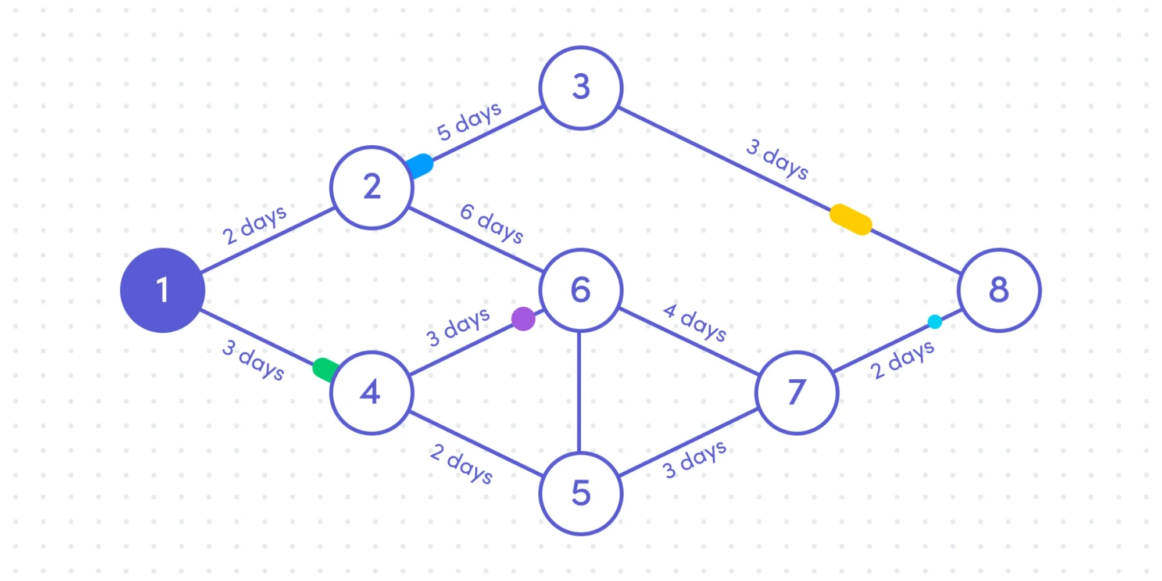

Slide 5
The numbers (1-8, in this case) help identify the tasks. The lines show order, duration, and dependencies.
For example, you can’t start activity 6 until both 2 and 4 are completed. So, the team responsible for that activity doesn’t need to start work until 8 days into the project (2 days for Task 1 plus 6 days for Task 2).

Slide 6
Features
• Automated CPM Calculations
Computes early start (ES), early finish (EF), late start (LS), late finish (LF), and slack for all tasks.
Highlights the critical path to determine project duration.
• Task Input and Management
Allows users to input tasks with durations and dependencies.
Displays task details in a tabular format for clear analysis.
• Interactive GUI
Features intuitive screens for input, output, and navigation.
Provides clear visual outputs for task data and results.
• Result Visualization
Displays task matrix, critical path, and project duration in an organized layout.
Uses tables and labeled sections for better readability.

Slide 7
Concepts used in this project-
Programming Languages:
Basic and advanced Java concepts.
Swing for creating interactive GUI application.
Resource Allocation: Principles of resource management and allocation.
Version Control: Use of Github for source code management.
Algorithms- Dynamic Approach:
CPM - Critical Path Method
Forward Pass and Backward Pass
DAG – Directed Acyclic Graph
Backflow Algorithm

Slide 8
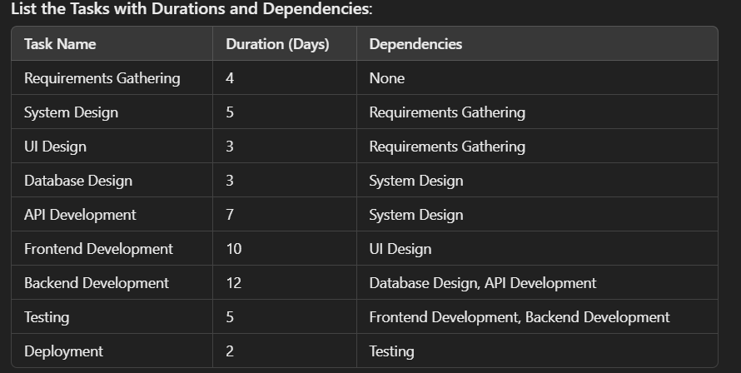
CPM
The Critical Path Method (CPM), also known as critical path analysis (CPA), is a project management technique that helps plan, schedule, and assess complex projects. It identifies the longest sequence of dependent tasks that must be completed before the project can be considered finished. By completing these tasks on time, the project can be completed as early as possible.

Slide 9
In the example above, the maximum Project Duration : 35 days. The longest path follows the tasks: Requirements Gathering → System Design → API Development → Backend Development → Testing → Deployment. The most prolonged project duration is known as the critical path, and it provides a clear timeline for project completion .

Slide 10
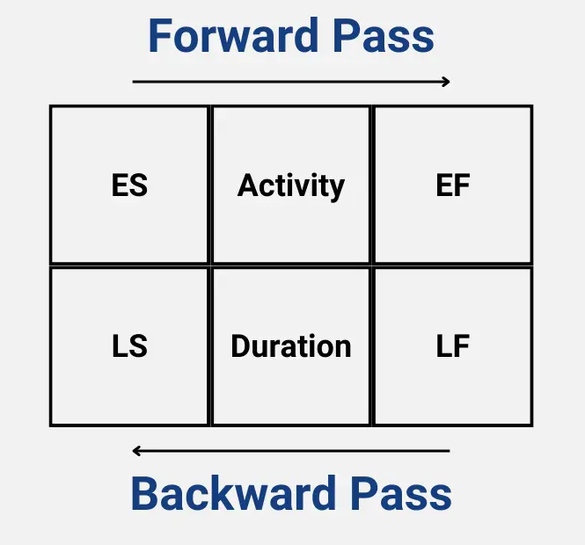
Forward Pass and Backward Pass
Forward pass is a technique to move forward through network diagram to determining project duration and finding the critical path or Free Float of the project.
Whereas backward pass represents moving backward to the end result to calculate late start or to find if there is any slack in the activity.

Slide 11
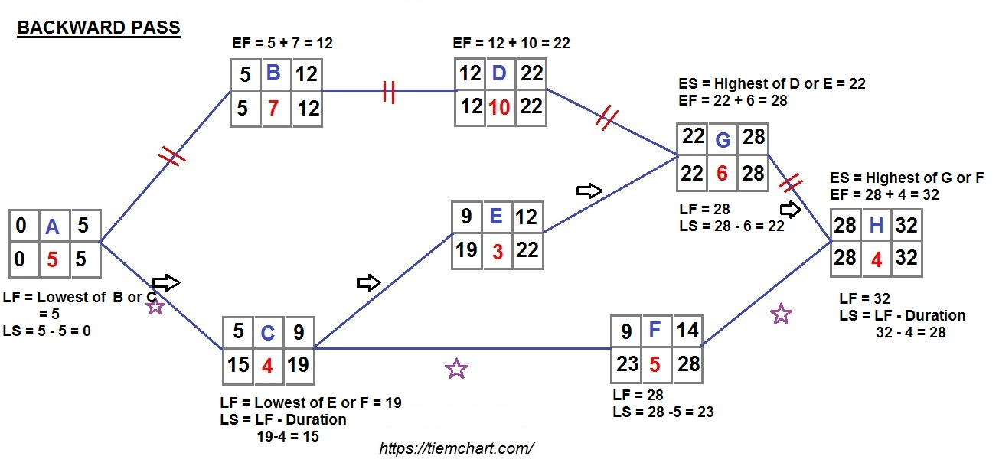








The whole idea of these diagram and finding the project duration is to identify the critical path and total duration of any project.

Slide 12
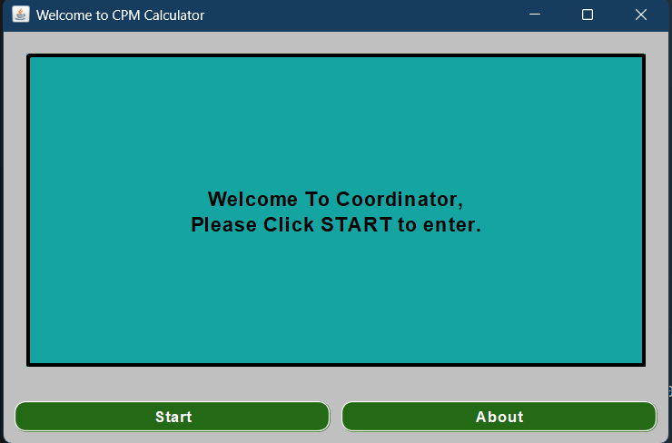
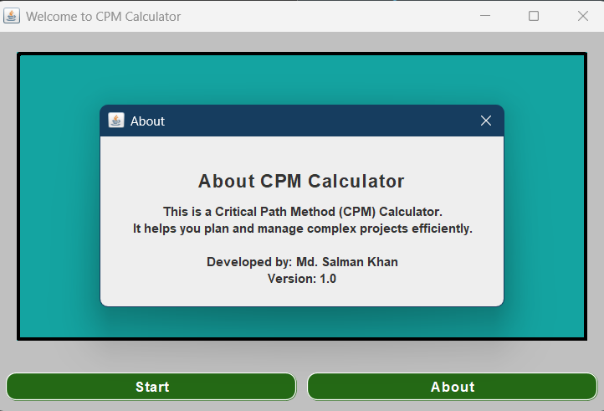
Welcome Page

Slide 13
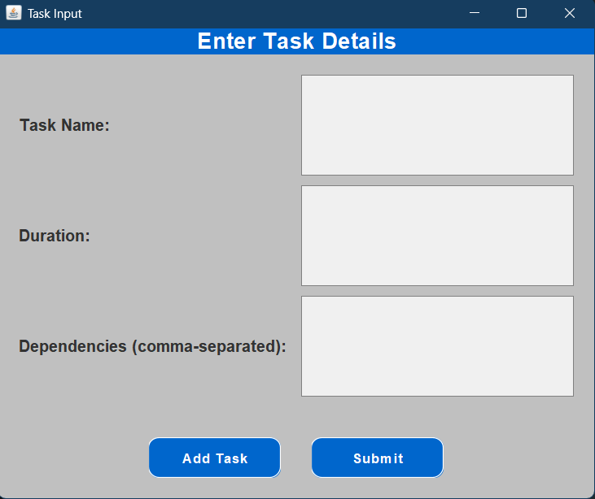
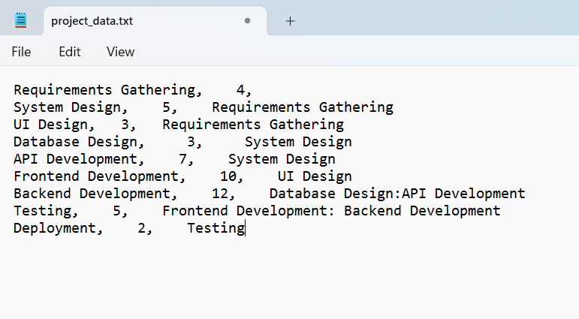
Input Page

Slide 14
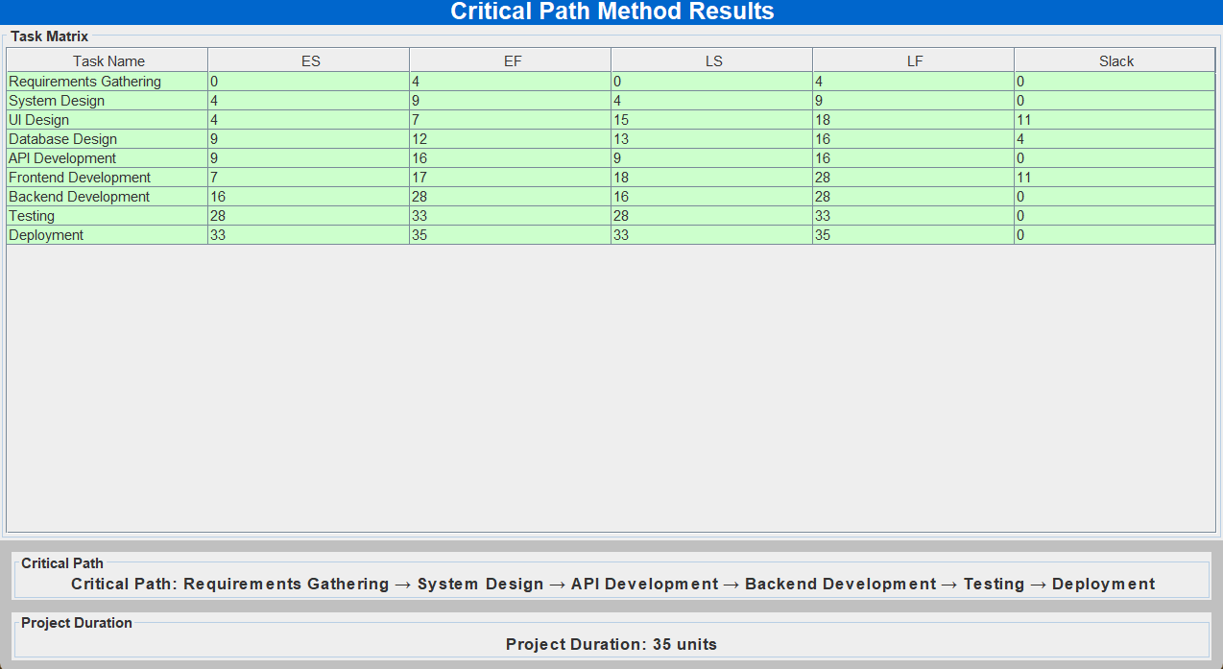
Output Page

Slide 15
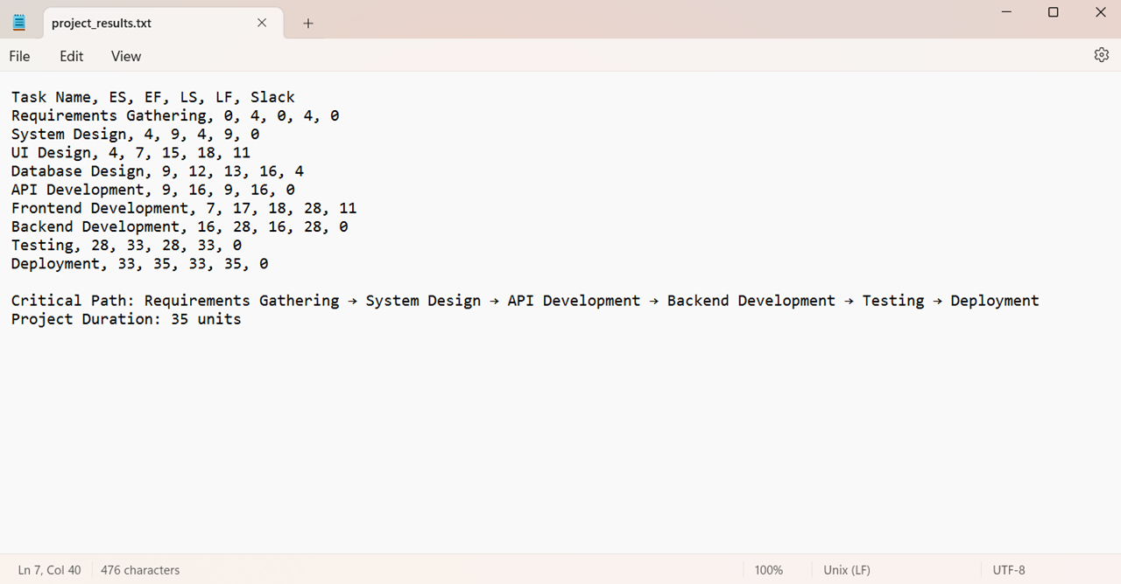
Output Page

Slide 16
Thank you for your attention!
I am now open to any questions or feedback you may have regarding the project I presented.

